Slide 1
STORY 5
File created on: 10/31/2023 9:13:57 AM

Slide 2
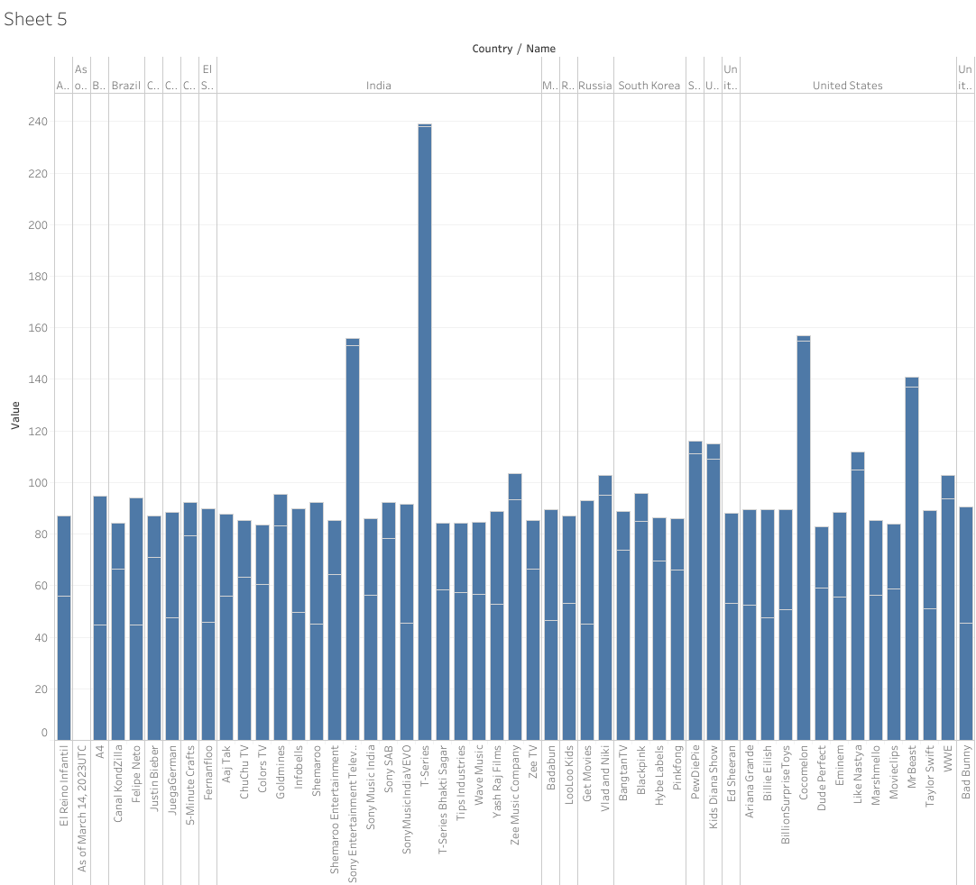

Slide 3
